Slide 1
WEATHER RELATED POWER OUTAGES
TEAM NAME : SYNERGY
TEAM NUMBER : TEAM 1
DEPARTMENT : ELECTRONICS AND COMMUNICATION ENGG.
COLLEGE : THIAGARAJAR COLLEGE OF ENGINEERING

Slide 2
S.NO | Name of the Team Member | Register Number | Role And Responsibilities
1] | KASTHURI.R | 63EC012 | TEAM LEADER - Initiates and leads the team efficiently.
2] | SHANMUHAM.S | 63EC001 | TASK EXECUTER - Divides the roles and responsibilities among the team members and take care of it.
3] | NIVEDITHA.M | 63EC015 | FINANCIAL OFFICER - Manages the financial activities of the team.
4] | SAHEEL AQTHAR.S | 63EC018 | PROJECT PARTNER LED – Act as a medium between the TEAM and CUSTOMER. ADVOCATE OF DEVIL – Point out the mistakes of the ideas frankly.
5] | NAGANATHAN.M | 63EC021 | WEB MASTER – Manages the technical work of the team. DESIGNER – Shares their innovative and creative way for a solution.
6] | AATHISHWARAN.D | 63EC019 | RECORDER – Manages the records of work done during this project course of time. DESIGNER – Shares their innovative and creative way for a solution.

Slide 3


SUSTAINABLE DEVELOPMENT GOALS
DEVELOP SUSTAINABLE, INNOVATIVEAND INCLUSIVE INFRASTRUCTURES: This may be one of the innovative ideas to turn off the transformer during havoc situations.
SUSTAINABLE ECONOMIC GROWTH: By reducing the cost of purchase and maintenance of the transformer and it creates decent jobs, entrepreneurship it including through access to financial services.

Slide 4
OVERVIEW
Introduction
Application
Societal Need/Need Assessment
Motivation/Purpose of the work and To whom
Existing/Current status
Patents
Publications (Reputed Journals/Conferences)
Voice of customer
Existing market products
Problem Formulation
Objectives
Scope and Constraints
Identification of Community Partner and Stakeholders

Slide 5
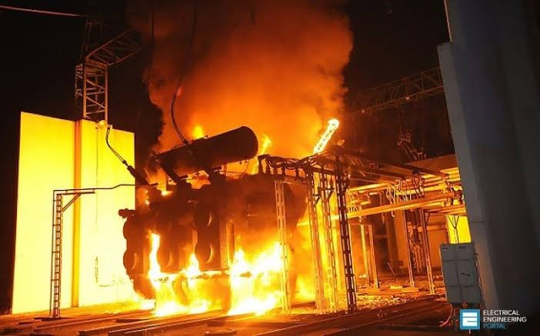
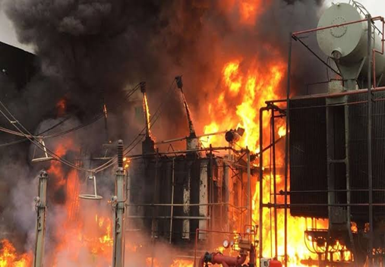
INTRODUCTION
High winds, especially when combined with precipitation can cause damage to electrical utility systems, resulting in service interruptions to large numbers of electricity consumers.
While most of the power outages are caused by damage from trees and tree limbs falling on local electricity distribution lines and poles.
Major power outages tends to be caused by damage to electrical transmission lines, which carry bulk power long distances.

Slide 6
APPLICATIONS
Can be used in government Electricity board and Industries during unconditional weather to avoid accidents.
Can also be used in Electric power generation plant to avoid damages.
Can be used to send the information to concerned sector about the status of the transformer.
Can reduce the difficulties of the workers to maintain the transformers during havoc situations.

Slide 7
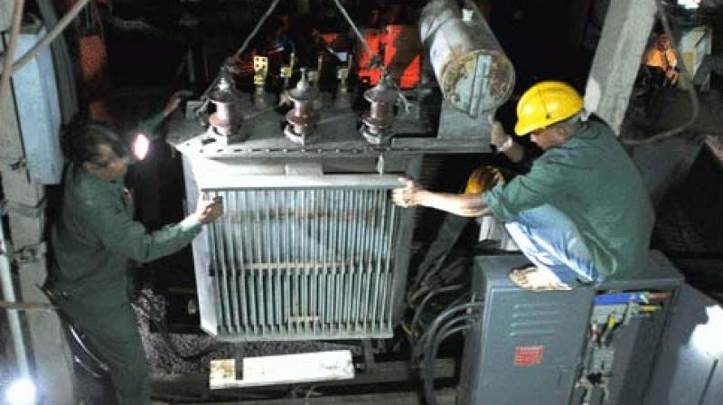
MOTIVATION
Avoid transformer from bursting out.
Reduce the power outage time.
Increase the life of the transformer.
Reducing the repairing cost and time
Avoid human death during heavy rain and wind timing.
Avoid long lasting power outages.

Slide 8
PROBLEM FORMULATION
Many electricity accidents causes during unconditional weather. During a storm power poles are vulnerable to the lighting strikes while strong winds can snap off tree branches and down power lines . To mitigate the problem, application of some innovative to reduce the power outages devices has been generally recognized as one of effective ways.
To increase the life of the transformer. By turning off the transformer automatically at unconditional weather.
Reducing the repairing cost and time for transformer.
To avoid long lasting power outages.
To overcome from the defects happened due to unconditional weather
To intimate easily to the Electricity board automatically.

Slide 9
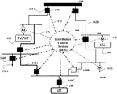
PATENTS
PATENT NUMBER/FILE | INVENTOR (S) | APPLICATIONS | DIAGRAM
WEATHER STRATEGIES POWER RESILIENCY (2020-10-13 Application granted 2020-10-13 Publication of US10804736B2) US10804736B2 https://patents.google.com/patent/US10804736B2/en?q=resiliency+weather+stratagies+power+outages&oq=resiliency+weather+stratagies+for+power+outages | Hongbo Sun Shiva Poudel | According to some aspects of the present disclosure, the power distribution system can be modeled with set of buses or nodes and set of edges. The restoration of distribution system can be viewed as splitting a (MILP) to be solved.

Slide 10
LITERATURE REVIEW
S.No | Author | Title | Name of the Journal/ Conference | Volume/ Issue/Year | Algorithm/ Method | Merits/ Demerits
1. 2. | K.Chen chen, R.Baldick Richard j. cambell | Integrating distributed generation into electric power systems Weather related power outages and electric system resiliency | Research on Resilience of Power systems under natural disaster Economic costs associated with storm related power outages www.ourenergypolicy.com/content/uploads/2016/02 | May 2015 August 28,2012 | Extreme weather has a significant impact on critical infrastructures and is considered one of the main casus of wide area electrical disturbance worldwide. Several defense plans for boosting the resilience of power systems to extreme weather events. Power outages can impact electricity consumers primarily through property loss and business disruption. | Electricity systems hardening can prevent some outages and shorten others, thus limiting the exposure to these risks. Some system hardening options can be quite costly. Recovery can be hastened,and the amount of damage to electric power infrastructure can be minimized. Storms can inflict damaged to electric power delivery system in a variety of ways.

Slide 11
EXISTING MARKET PRODUCTS
As per our knowledge there is no existing product based on our idea.
OUT OF THE BAG SAMPLING

Slide 12
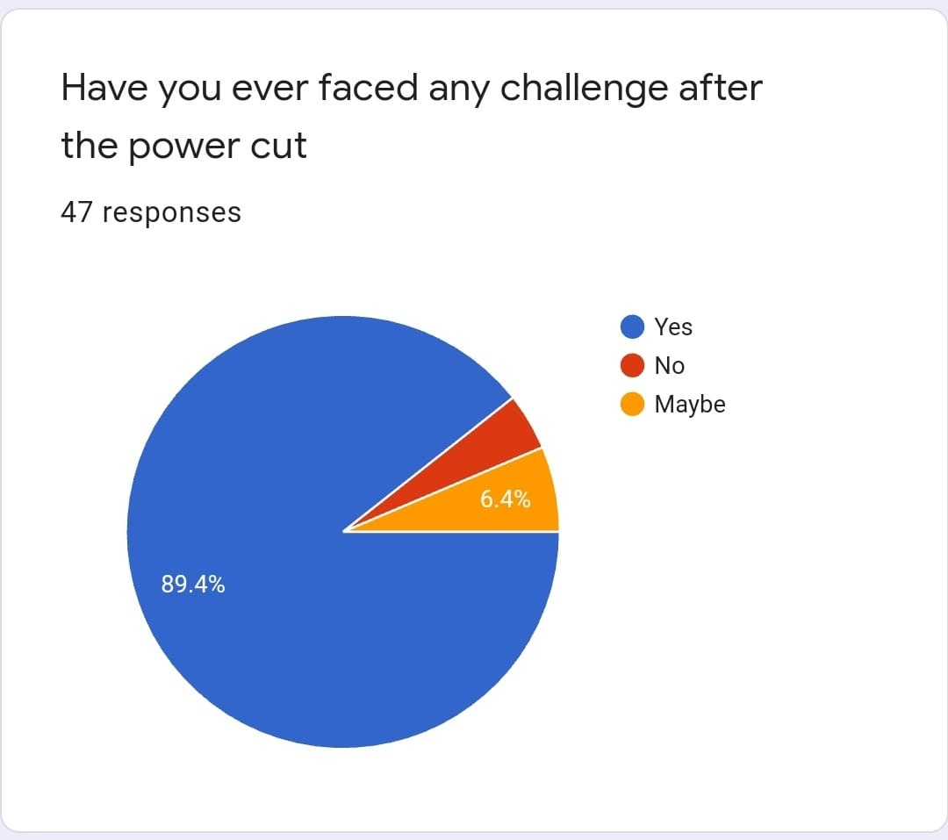
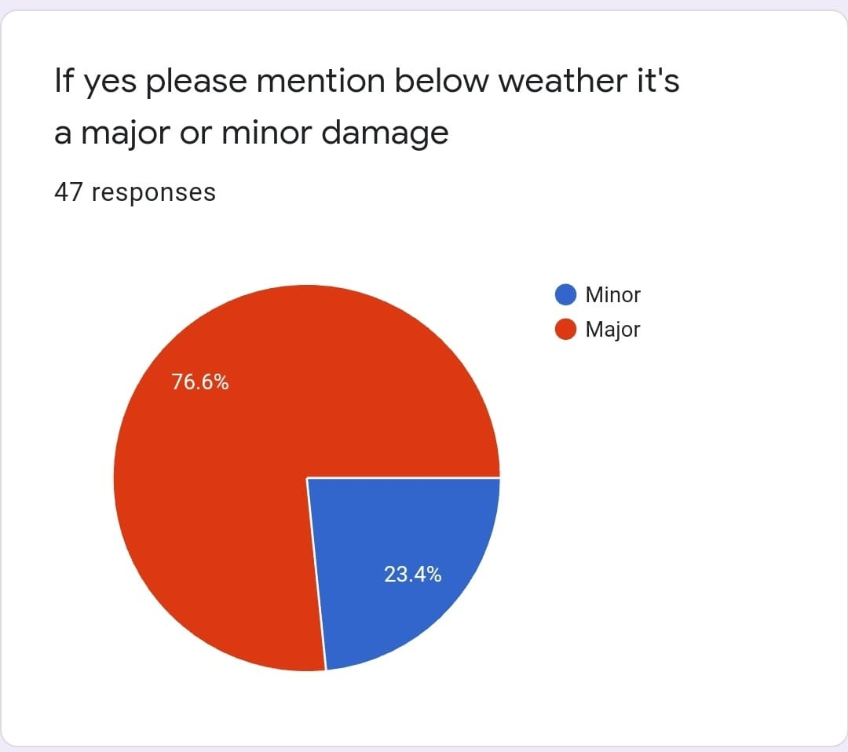
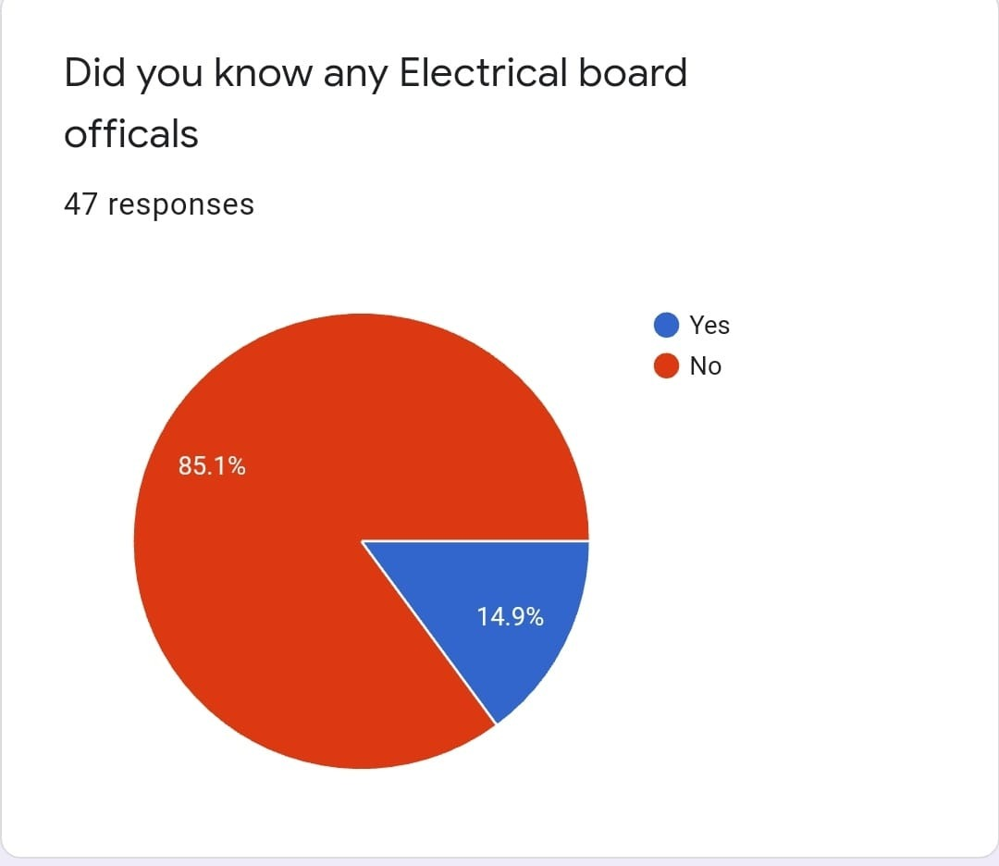
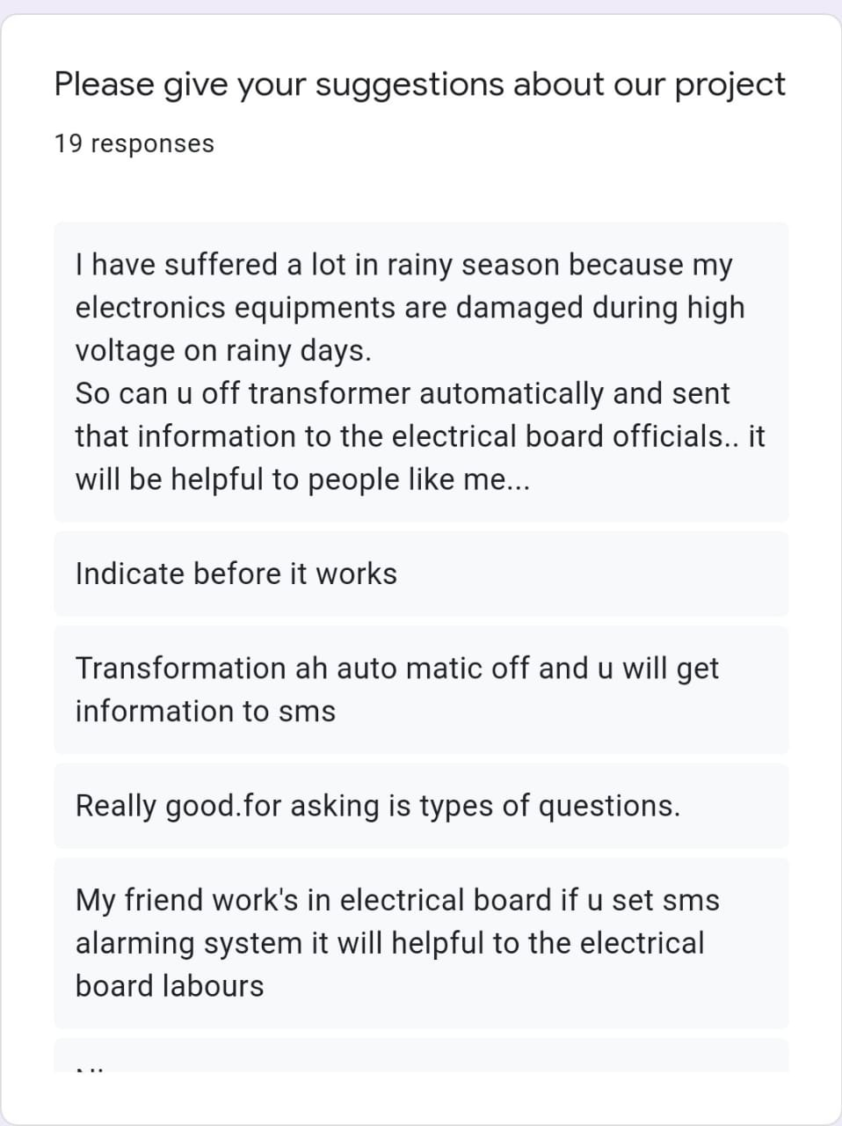
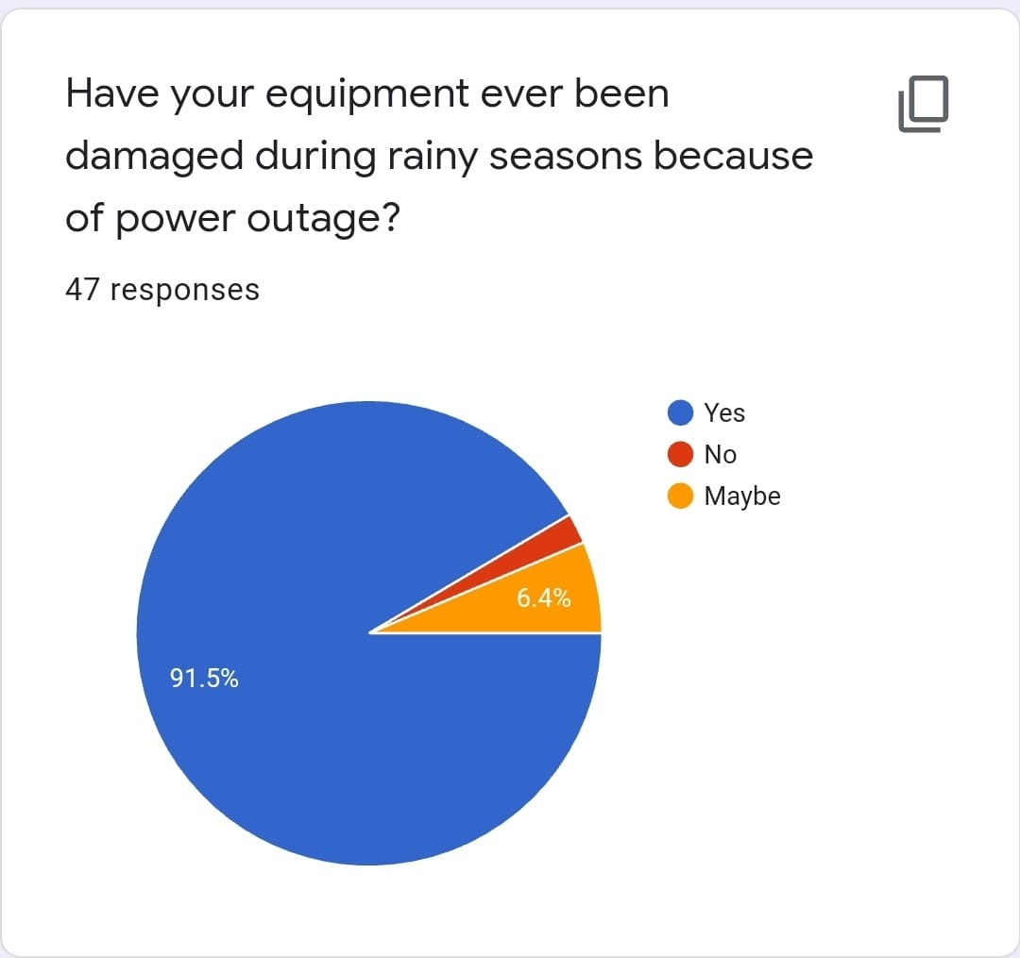
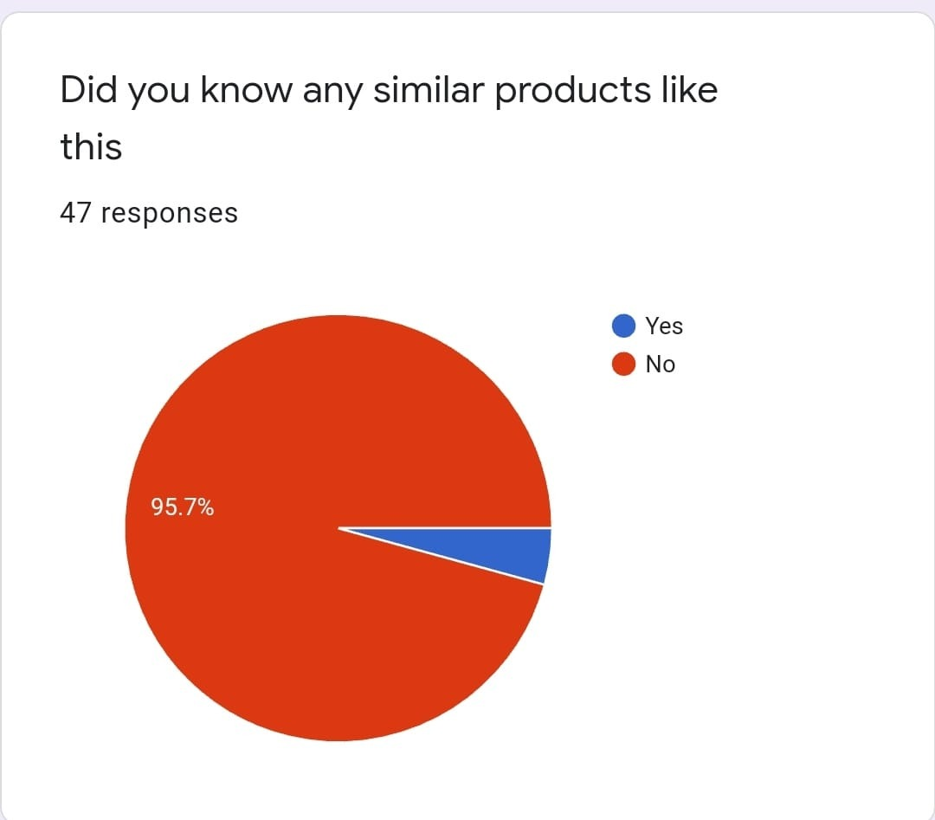
VOICE OF CUSTOMERS

Slide 13
INFERENCE
FROM THE PIE CHARTS
According to the survey conducted, most people has faced the problem due to power outages in the unconditional weather
Which specifies that our PROJECT will a SUCCESSFUL one.

Slide 14
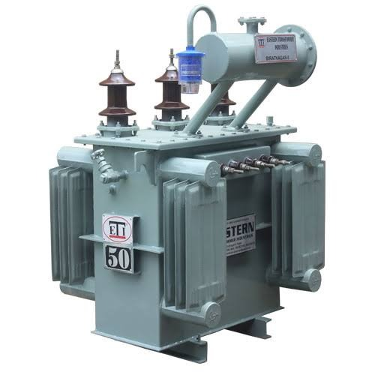
OBJECTIVE
Based on the problems formulated, objectives are
To resilience the power outages during weather changes.
To send a message information to EB office.
To measure the wind speed and rain level using sensor.
To Automatic turn off the transformer.

Slide 15
SCOPE/CONSTRAINTS
SCOPES:
Immediate alert to EB office.
Protect the components in the home as well as equippments in transformer.
Future implementation in HT line.
Creating job for technical persons.
CONSTRAINTS:
Only knowledgeable person can operate
Fear on automatic to implement in live wires
Currently workers are less in EB to identify the fault if it turn off automatically.

Slide 16
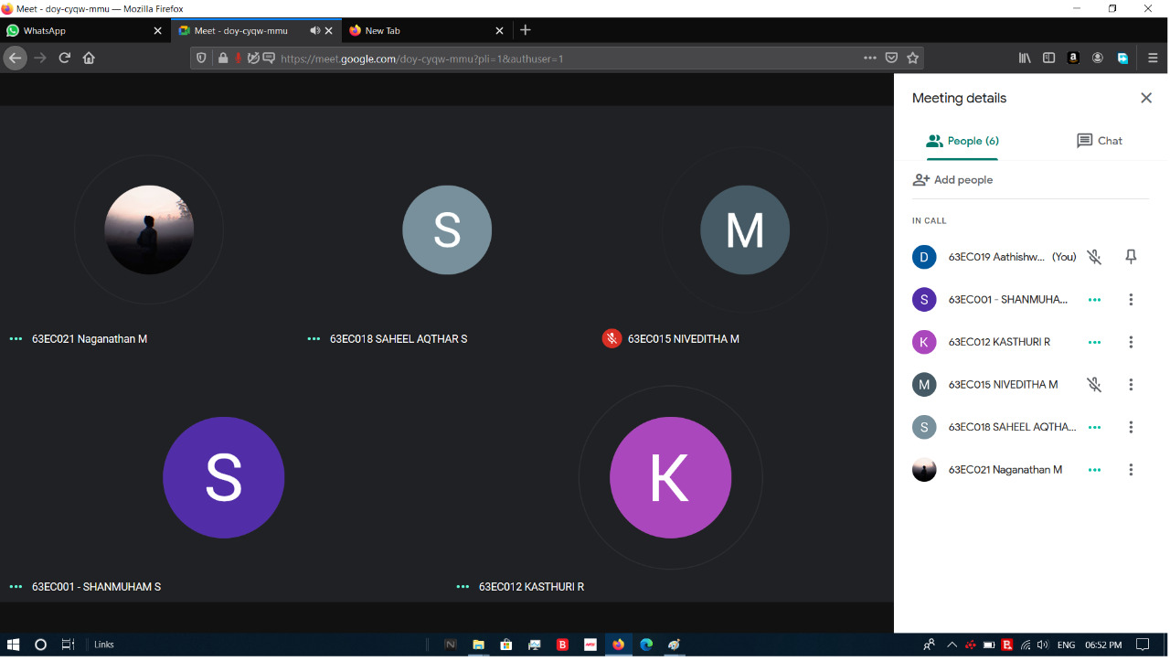
BRAINSTORMING SESSION
16/12/2020
COMPONENT & BLOCK DIAGRAM DISCUSSION DRIVE FILE:
https://drive.google.com/file/d/1zMxdlfdMS7VrT7fnoUyWjAIt8_BRddN5/view?usp=sharing
18/12/2020

Slide 17
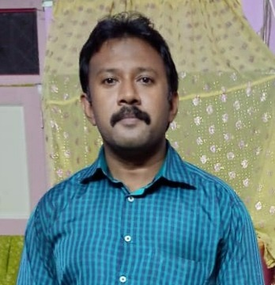
STAKEHOLDER
NAME : ABDUL KADAR.M
OCCUPATION : ASSISTANT ENGINEER
WORKING IN : TNEB, THIRUPPATHUR
YEAR OF EXPERIENCE : 10 YEARS

Slide 18
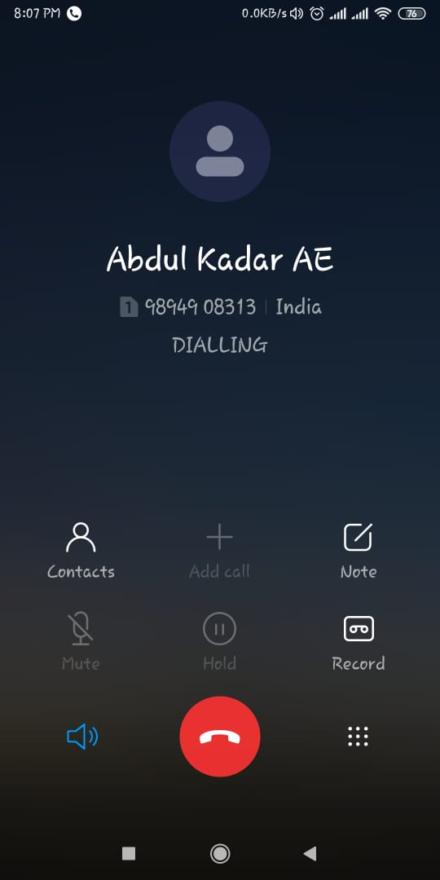
INTERACTIVE SESSION WITH STAKEHOLDER

Slide 19
STAKEHOLDER’S REQUIREMENTS
PHYSICAL:
It must be compact in size
It should be easily understandable
FUNCTIONAL/OPERATIONAL:
simple connections
It should be turn off at correct situation
ENVIRONMENTAL:
Ecofriendly
ECONOMIC:
It must be cost efficient
TECHNICAL:
It should not malfunction at any time
REGULATORY:
As much as it comes minimum 3 to 4 years
PERFORMANCE:
It must be Accurate at any situation.
Message should be send correctly at the time.

Slide 20
BLOCK DIAGRAM
TRIPPING CIRCUIT
RAIN SENSOR
230V (AC)
RELAY
DRIVER
PIC MICROCONTROLLER
SIGNAL CONDITIONONG UNIT
P N
WIND SENSOR
POTENTIAL TRANSFORMER
SIGNAL CONDTIONING UNIT
SIGNAL CONDITIONING UNIT
CURRENT TRANSFORMER
SIGNAL
CONDITINING
UNIT
BUZZER
LEVEL CONVERTER
RELAY
LOAD
LCD DISPLAY
GSM

Slide 21
THANK YOU

